Slide 1
New Horizon for Overcoming Hormonal Tx Resistance in
MBC Patients
NEW AGENT=NEW HOPE
AL BEIRUNI UNIVERSITY HOSPITAL
HAZEM KSIRI. MD
14-15-16/12/2023

Slide 2
Introduction
Breast cancer is the most common cancer disease among women
Approximately 70% of all tumors express the estrogen receptor (ER)
It’s a transcription factor that is activated by estrogen binding and that regulates the expression of various genes involved in tumor formation.
Two isoforms exist:
ERα, which is predominantly expressed in breast cancer and the main target of endocrine therapy
ERβ, which seems to have an opposite effect to ERα and inhibits estrogen-dependent cell proliferation

Slide 3
Introduction
Endocrine therapy is one of the most effective treatment options for ER-positive breast cancer.
In the metastatic setting, it is the therapy of choice, except in cases of immediately life-threatening disease, i.e., a visceral crisis.
Classical endocrine therapies modulate the estrogen effect by blocking the ER (selective ER modulators, SERMs) like tamoxifen.
Aim to reduce estrogen levels (e.g., the aromatase inhibitors [AIs] letrozole, anastrozole, and exemestane) should only be used in the postmenopausal situation.
Fulvestrant ( SERD)

Slide 4
Introduction
A major challenge in treating ER-positive breast cancer is to overcome endocrine resistance.
Primary endocrine resistance:
Early breast cancer: relapse within 2 years of adjuvant endocrine treatment.
Advanced breast cancer or MBC: disease progression during the first 6 months of first-line endocrine therapy.

Slide 5
Introduction
A major challenge in treating ER-positive breast cancer is to overcome endocrine resistance.
Secondery endocrine resistance:
Early breast cancer: as a relapse that occurs after at least 2 years of endocrine therapy and during or within the first year of completing adjuvant endocrine therapy.
Advanced breast cancer or MBC: defined as disease progression after more than 6 months of endocrine therapy.

Slide 6
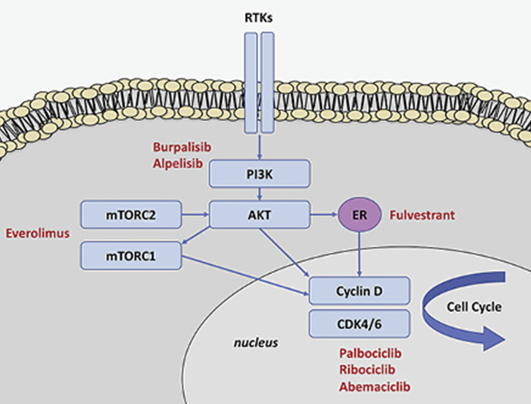
Mechanisms of Endocrine Resistance
Receptor Tyrosine Kinases Family of cell membrane-bound receptors
[EGFR/ErbB family] [IGFR] [VEGFR] [FGFR]
Cell Cycle Regulators cyclin D/cyclin-dependent kinases (CDK) 4/6 pathway
ESR1 Mutations

Slide 7
ESR1 Mutations
Rare in primary breast cancer
High prevalence (20–40%) in patients with MBC who have previously received endocrine treatment
Most mutations (D538G, Y537S, Y537N, Y537C, and E380)
Occur at hot spots in the ligand-binding domain of ERα resulting in constitutive ER activity.
BOLERO-2 trial - SoFEA trial

Slide 8
ESR1 Mutations
Systemic Treatment
Endocrine therapy ( for HR- positive): (According to available medications) (BC that have at least 1% of cell stainig positive for HR should be considered HR- Positive) | First line therapy( for postmenopausal or premenopausal receiving ovarian ablation or suppression)
 | AI+ CDK4/6 Inhibitors (+/- Bisphosphonate) (preferred) for her2- negative (see Eligibility Criteria) Fluvestrant + CDK 4/6 Inhibitors (preferred) for her2- negative (see Eligibility Criteria) Aromatase inhibitors TAM
 | second line therapy( for postmenopausal or premenopausal receiving ovarian ablation or suppression)
 | Fluvetrant + CDK4/6 Inhibitors(If CDK4/6 inhibitors not previously used ( preferred). Fuvestrant + Alpelisib for PIK3CA – mutated tumors (Preferred 1). Everolimus + Endocrine therapy. Aromatase Inhibitors. Selective ER down-regulation (Fluvestrant). Selective estrogen receptor modulator ( Tamoxifen or Toremifene).

Slide 9
Elacestrant (oral selective estrogen receptor degrader) Versus Standard Endocrine Therapy for Estrogen Receptor–Positive, Human Epidermal Growth Factor Receptor 2–Negative Advanced Breast Cancer: Results From the Randomised Phase III EMERALD Trial
Randomized, open-label, active-controlled, multicenter trial
Francois-Clement Bidard, MD1,2; Virginia G. Kaklamani, MD3; Patrick Neven, MD4; Guillermo Streich, MD5; Alberto J. Montero, MD6;
Fr ´ed´ eric Forget, MD7; Marie-Ange Mouret-Reynier, MD8; Joo Hyuk Sohn, MD9; Donatienne Taylor, MD10; Kathleen K. Harnden, MD11;
Hung Khong, MD12; Judit Kocsis, MD13; Florence Dalenc, MD14; Patrick M. Dillon, MD15; Sunil Babu, MD16; Simon Waters, MD17;
Ines Deleu, MD18; Jos´e A. Garc´ıa S´aenz, MD19; Emilio Bria, MD20; Marina Cazzaniga, MD21; Janice Lu, MD22; Philippe Aftimos, MD23;
Javier Cort ´ es, MD24,25,26,27; Shubin Liu, MS28; Giulia Tonini, PhD29; Dirk Laurent, MD30; Nassir Habboubi, MD31;
Maureen G. Conlan, MD32; and Aditya Bardia, MD33
PURPOSE Patients with pretreated estrogen receptor (ER)–positive/human epidermal growth factor receptor 2
(HER2)–negative advanced breast cancer have poor prognosis. Elacestrant is a novel, oral selective ER degrader
that demonstrated activity in early studies

Slide 10
EMERALD Trial
478 postmenopausal women and men with ER-positive, HER2-negative
advanced or metastatic breast cancer
228 patients had ESR1 mutations.
disease progression on one or two prior lines of endocrine therapy, including one line containing a CDK4/6 inhibitor
patients could have received up to one prior line of chemotherapy in the advanced or metastatic setting.

Slide 11
EMERALD Trial
N= 239
Elacestrant
345mg QD.
Inclusion criteria
R
a
n
d
o
m
i
z
a
t
I
o
n
1:1
Advanced/ metastatic ER+/HER- breast cancer.
Progressed or relapsed or after 1 or 2 lines of endocrine therapy, 1 of which was given in combination with CDK4/6 inhibitor, for advanced or metastatic breast cancer.
ECOG PS 0 or 1.
Investigator’s choice of:
Fluvestrant. N=166
Anastrazole. N=73
Letrozole.
Exemestane.
N= 239
Stratification factors:
ESR1 mutation: Y/N.
Prior treatment with fulvestrant: Y/N.
Presence of visceral metastases: Y/N.

Slide 12
A
100
Elacestrant
SOC
90
(n = 239)
(n = 238)
80
Events, No. (%)
144 (60.3)
156 (65.5)
70
HR (95% CI)
0.70 (0.55 to 0.88)
P
0.0018
60
6-month PFS, %
34.3
20.4
PFS (%)
(95% CI)
(27.2 to 41.5)
(14.1 to 26.7)
50
12-month PFS, %
22.3
9.4
40
(95% CI)
(15.2 to 29.4)
(4.0 to 14.8)
30
20
10
Elacestrant
SOC
1
2
3
4
5
6
7
8
9
10
11
12
13
14
15
16
17
18
19
20
21
22
23
24
25
Time (months)
No. at risk:
Elacestrant
239
223
106
89
60
57
42
40
34
33
27
24
19
13
11
8
7
6
622221
0
SOC
238
206
84
68
39
38
25
25
16
15
7
4
3
3
2
2
1
0

Slide 13
C
100
Elacestrant
Fulvestrant
(n = 239)
(n = 165)
90
Events, No. (%)
144 (60.3)
109 (66.1)
80
HR (95% CI)
0.68 (0.52 to 0.90)
P
.0049
70
6-month PFS, %
34.3
22.86
(95% CI)
(27.2 to 41.5)
(15.15 to 30.57)
60
12-month PFS, %
22.3
10.15
PFS (%)
(95% CI)
(15.2 to 29.4)
(3.44 to 16.86)
50
40
30
20
Elacestrant
10
Fulvestrant
0
1
2
3
4
5
6
7
8
9
10
11
12
13
14
15
16
17
18
19
20
21
22
23
2
4
25
Time (months)
No. at risk:
Elacestrant
239
106
60
42
34
27
19
11
7
62
2
0
Fulvestrant
165
62
33
21
14
5
2
1
0

Slide 14
D
100
Elacestrant
Fulvestrant
90
(n = 115)
(n = 83)
Events, No. (%)
62 (53.9)
59 (71.1)
80
HR (95% CI)
0.50 (0.34 to 0.74)
70
P
.0005
60
6-month PFS, %
40.8
20.75
PFS (%)
(95% CI)
(30.1 to 51.4)
(10.68 to 30.83)
50
12-month PFS, %
26.8
8.41
40
(95% CI)
(16.2 to 37.4)
(0.21 to 1.66)
30
20
Elacestrant
10
Fulvestrant
0
1
2
3
4
5
6
7
8
9
10
11
12
13
14
15
16
17
18
19
20
21
22
23
2
4
25
Time (months)
No. at risk:
Elacestrant
115
54
35
26
21
16
11
7
5
411
0
Fulvestrant
83
29
16
10
8
3
1
0

Slide 15
Among the ESR1-mutated population
progression-free survival was also improved with longer prior exposure to CDK4/6 inhibitors.
12 months and more of prior exposure to CDK4/6 inhibitors: median progression-free survival was 8.6 months with elacestrant vs 2.1 months with the standard of care, a 53% reduction in the risk for disease progression or death.
At least 6 months of prior treatment with CDK4/6 inhibitors:
median progression-free survival was 4.1 months vs 1.9 months, respectively.
EMERALD Trial . By Alice Goodman
October 10, 2023 - Supplement: Breast Cancer Almanac – ASCO POST

Slide 16
A
100
Elacestrant
SOC
90
80
70
60
OS (%)
50
Elacestrant
SOC
40
(n = 239)
(n = 238)
Events, No. (%)
70 (29.3)
79 (33.2)
30
HR (95% CI)
0.75 (0.54 to 1.04)
P
.0821 (NS)
20
6-month OS, %
93.0
85.2
(95% CI)
(89.7 to 96.3)
(80.5 to 90.0)
10
12-month OS, %
79.3
73.3
(95% CI)
(73.8 to 84.7)
(67.2 to 79.4)
0
1
2
3
4
5
6
7
8
9
10
11
12
13
14
15
16
17
18
19
20
21
22
23
24
25
26
27
Time (months)
No. at risk:
Elacestrant
239
233
230
229
220
218
211
202
197
191
180
166
139
118
98
89
78
60
49
33
22
10
5
2
2
2
0
SOC
238
223
216
206
164
187
179
177
173
163
157
144
118
96
78
67
49
42
31
23
15
6
3
1
1
1
0

Slide 17
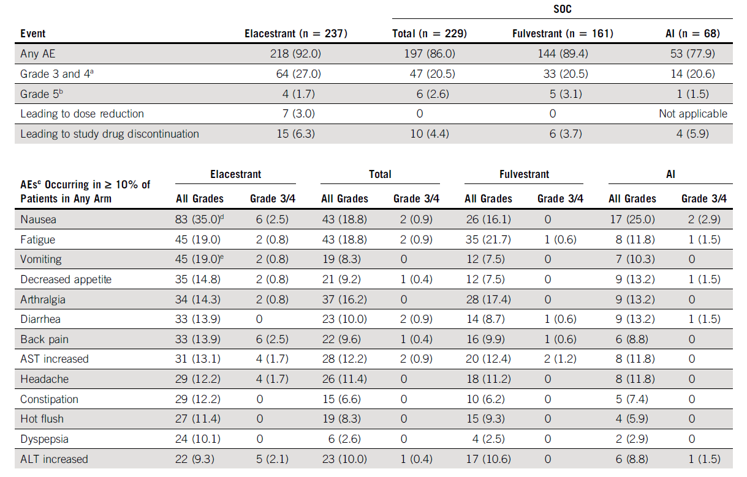

Slide 20
Elacestrant
The recommended dose is 345 mg PO qDay with a high-fat meal until disease progression or unacceptable toxicity.
The most common adverse events (≥10%), including musculoskeletal pain, nausea, increased cholesterol, increased AST, increased triglycerides, fatigue, decreased hemoglobin, vomiting, increased ALT, decreased sodium, increased creatinine, decreased appetite, diarrhea, headache, constipation, abdominal pain, hot flush, and dyspepsia.
Half-life: 30-50 hr
Hepatic impairment:
(Child-Pugh A): No dosage adjustment recommended
(Child-Pugh B): Reduce dose to 258 mg qDay

Slide 21
Thank you

